Slide 1
Project: TA Report System
IE04 Phase 3 Presentation
2022/1/11
Team: Sauce Katsudon

Slide 2
Our Vision
Goal: A system that is simple and easy to use, in order to assist students, lecturer, and staff to submit, manage and approve TA/SA report.
What we want to do:
Simplify the process of submitting the report
Staff can check and manage the reports easily
TA/SA can input their working time easily and will be able to keep track of the total working hours
Lecturers can see all the TA/SA of the course they’re teaching (progress of each TA/SA)

Slide 3
Progress
Next goal
Created views:
Student login
Lecturer login
Student main
Lecturer main
Student report calendar
User login authentication
Working hours input
Monthly report

Slide 4
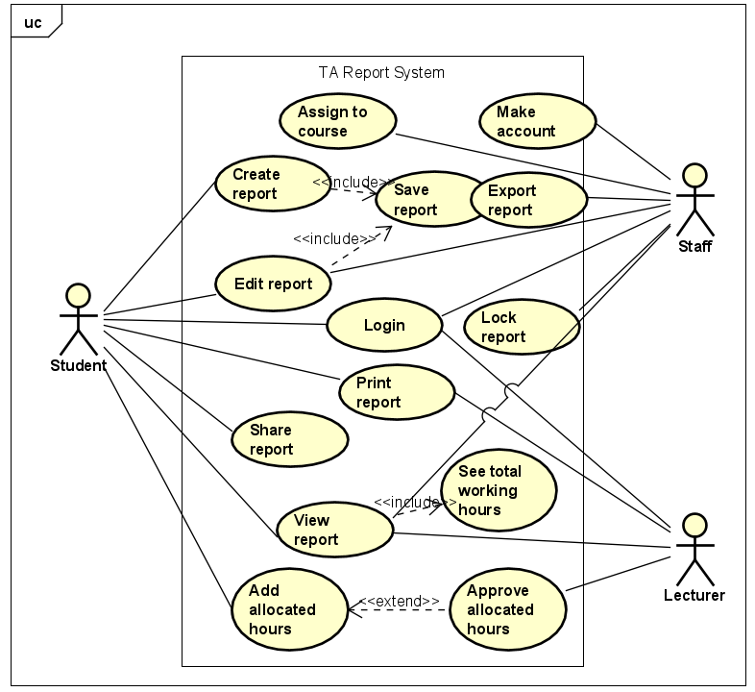
Use Case
Diagram

Slide 5
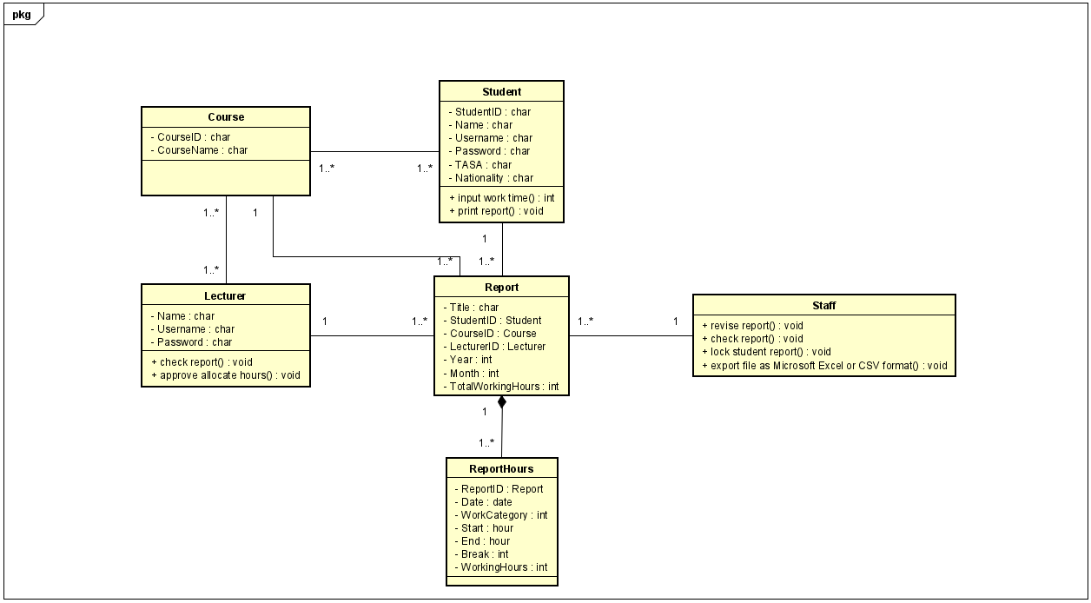
Class Diagram

Slide 6
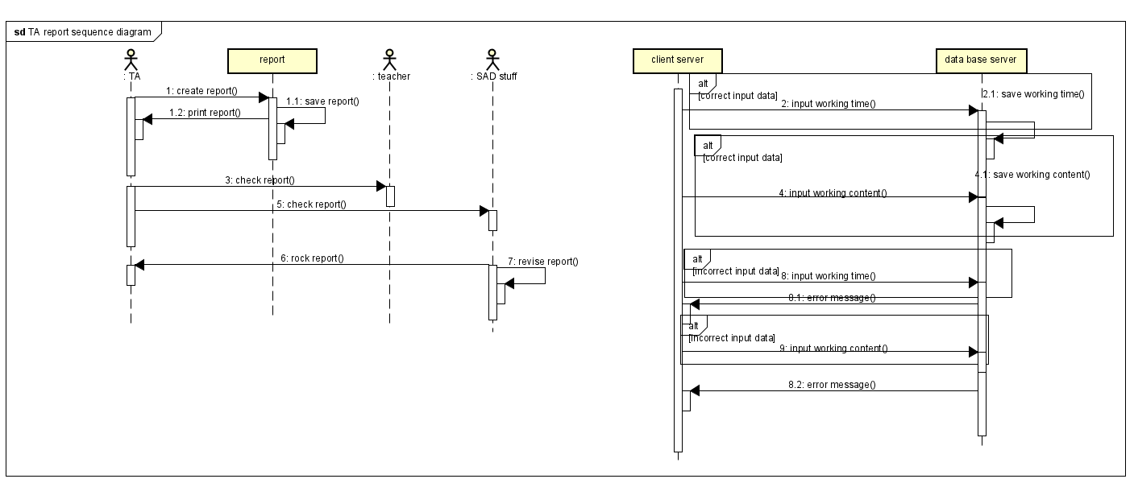
Sequence Diagram

Slide 7
Demo

